Slide 1
Build your first Neural Network

Slide 2
Packages
Tensorflow/ Theano
Keras
Matplotlib

Slide 3

Neural Networks

Slide 4
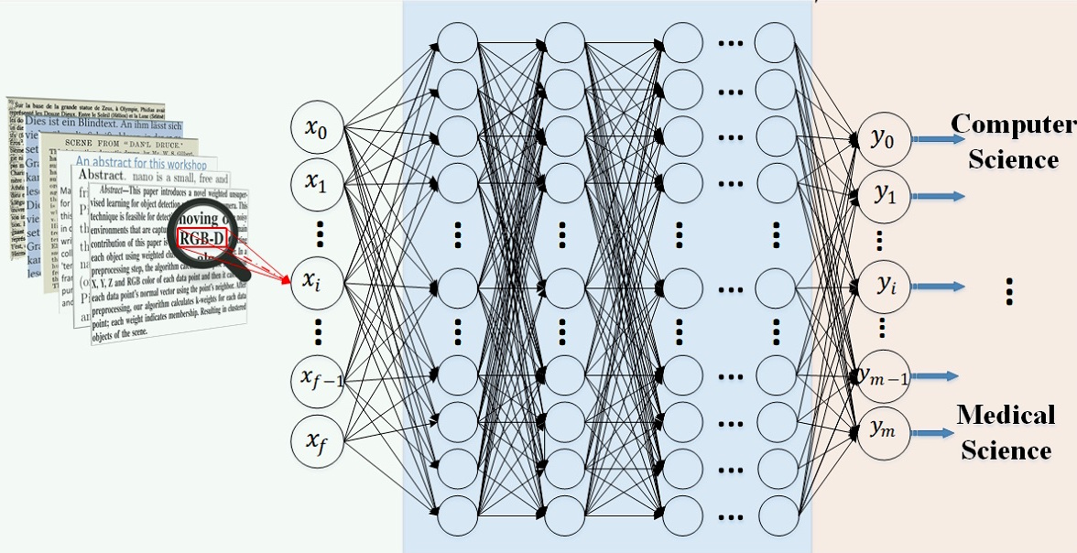
Deep Learning

Slide 5
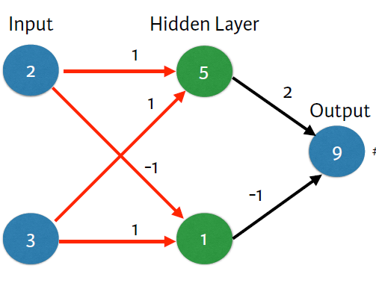
Forward Propagation

Slide 6
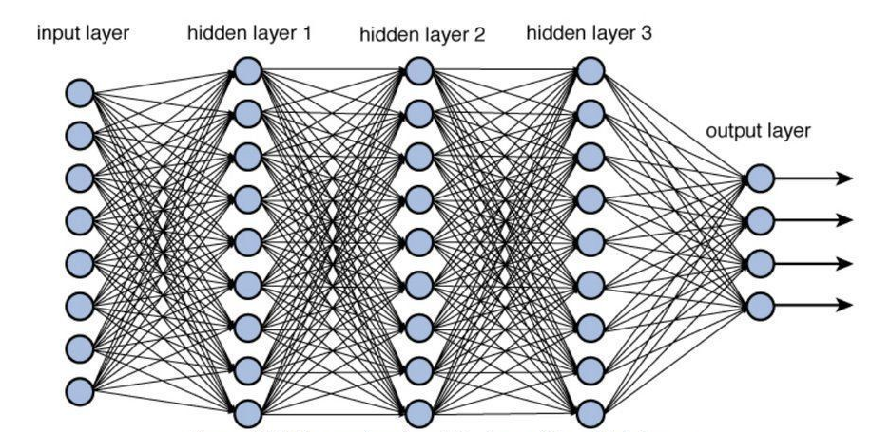
Forward Propagation

Slide 7
Bias
Threshold for firing

Slide 8
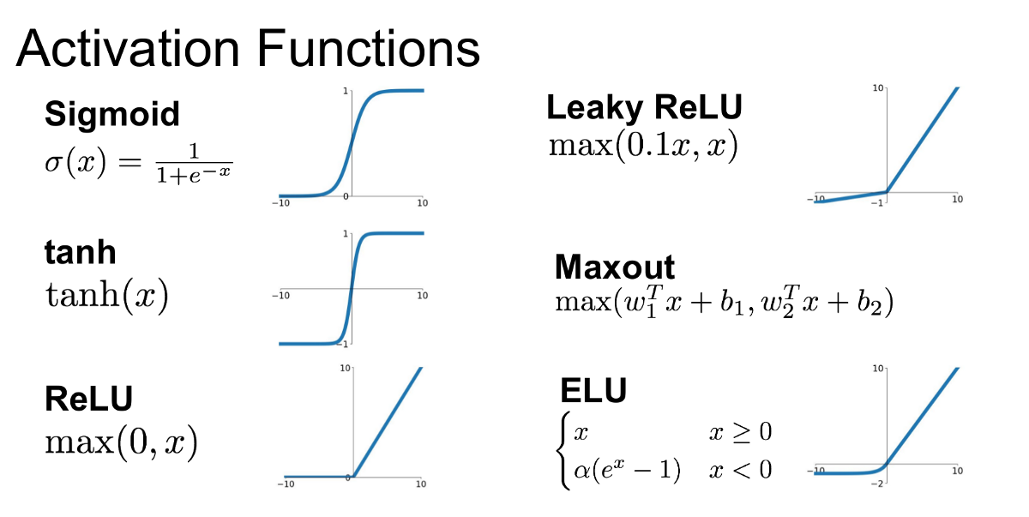
Activation Functions

Slide 9
Let’s build a Keras model!

Slide 10
Let’s build a Keras model!
from keras.models import Sequential
from keras.layers import Dense, Conv2D, Dropout, Flatten, MaxPooling2D

Slide 11
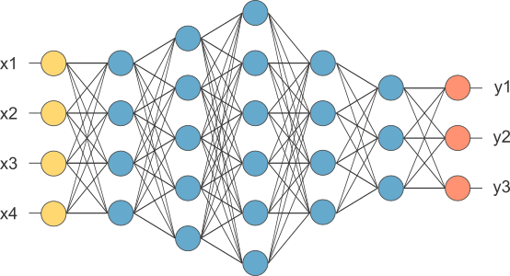

Slide 12
model.add(Dense)
model.add(Dense(4)
model.add(Dense(4,activation="relu")

Slide 13
Prepare Data
Build Model
Compile
Fit
Predict

Slide 14
Prepare data
scaler = MinMaxScaler(feature_range=(0,1))
scaled_train_x = scaler.fit_transform((train_x).reshape(-1,1))

Slide 15
compile
model.compile(Adam(lr=.0001), loss='sparse_categorical_crossentropy', metrics=['accuracy'])

Slide 16
fit
model.fit(scaled_train_x, train_y, validation_split=0.1, epochs=20, verbose=2)

Slide 17
MNIST
Dataset of 60.000 handwritten digits
from keras.datasets import mnist
(x_train, y_train), (x_test, y_test) = mnist.load_data()
Notes:
X and Y
Why is training and testdata split?

Slide 18
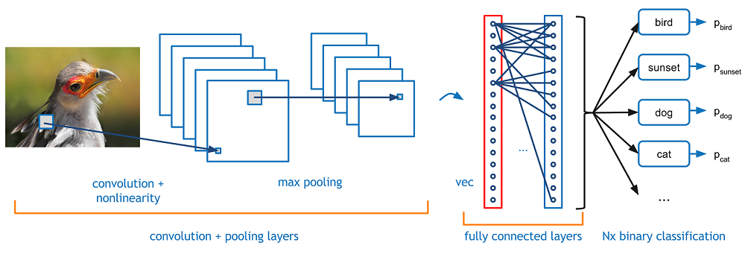
Convolutional Neural Network

Slide 19
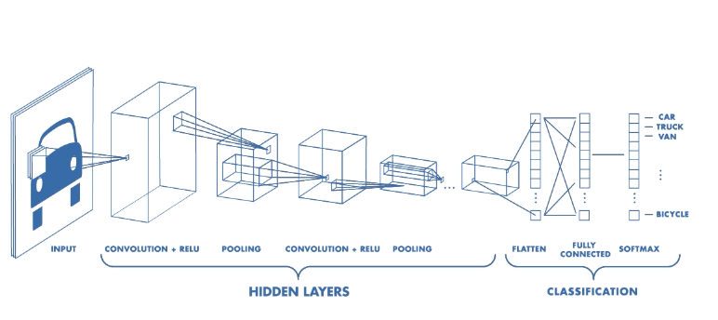
CNN

Slide 20
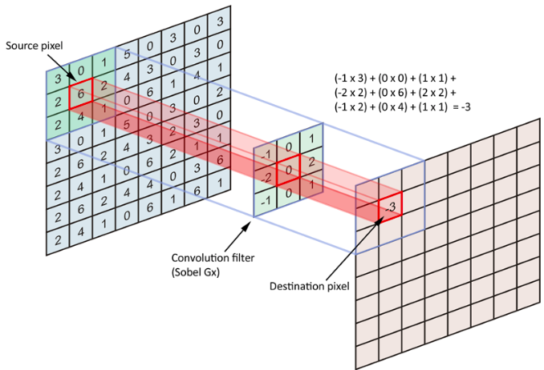

Slide 21
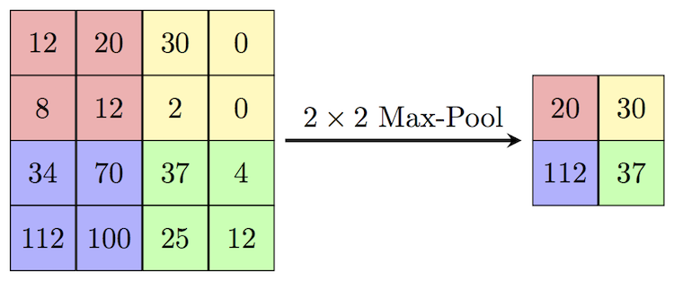

Slide 22
Plot Image
import matplotlib.pyplot as plt
plt.imshow(x_train[5], cmap='Greys')
print(y_train[5])

Slide 23
Prepare Data
Build Model
Compile
Fit
Predict

Slide 24
Preparing Data
Shape
Normalizing

Slide 25
Prepare Data
Build Model
Compile
Fit
Predict

Slide 26
Saving your model
model.save('saved_model.h5')

Slide 27
Loading your model
from keras.models import load_model
new_model = load_model('saved_model.h5')

Slide 28
Saving weights
model.save_weights('my_model_weights.h5')

Slide 29
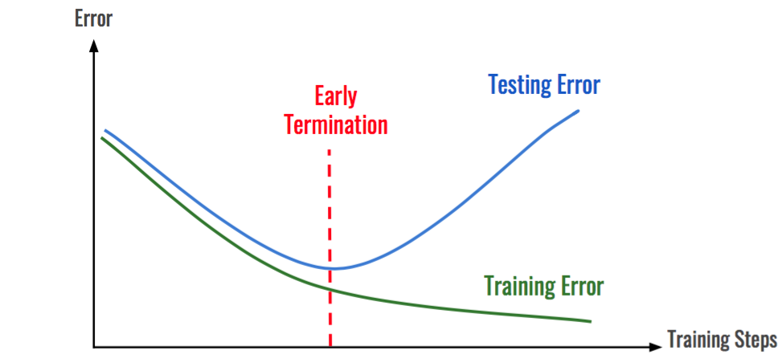
Overfitting

Slide 30
Validation set
model.fit(x=x_train,y=y_train, epochs=1, validation_split=0.3)

Slide 31
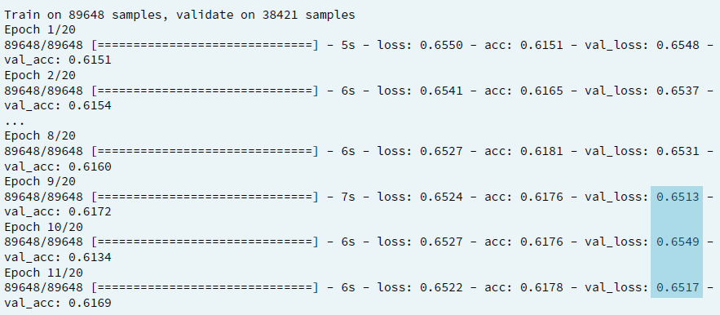
Early stopping
model.fit(x=x_train,y=y_train, epochs=1, validation_split=0.3, callbacks = [early_stopping_monitor])

Slide 32
Thank You

